Slide 1
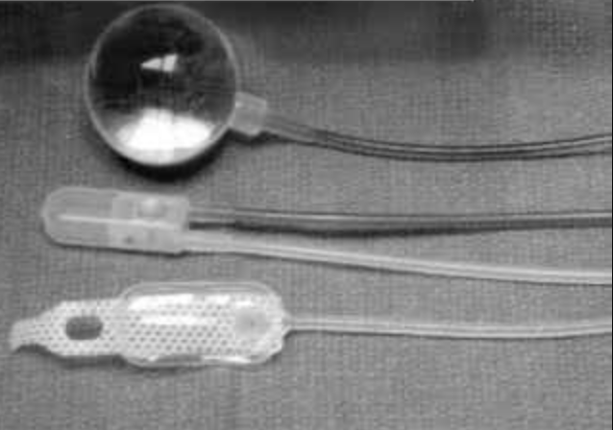
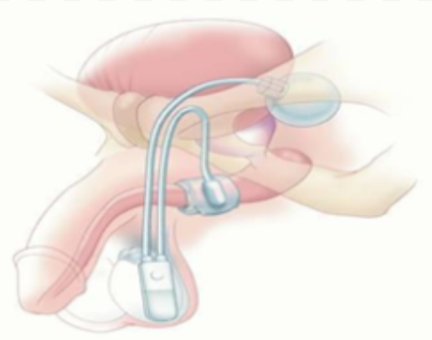
FDA Alternative Summary Reporting of Adverse Events Associated with the Artificial Urinary Sphincter
Jeffrey Lee, Daniel Rabinowitz, Ariel Schulman, Jacob Khurgin
Division of Urology, Maimonides Medical Center Brooklyn, NY
MP 0-02
Introduction
Results
The Artificial Urinary Sphincter (AUS) is considered the gold standard of male stress urinary incontinence (SUI) treatment.
The FDA made the Alternative Summary Report (ASR) publicly available. The dataset describes adverse events associated with medical devices such as the AUS.
AUS consists of an implanted urethral cuff, fluid reservoir and pump placed in the scrotum.
Device failure occurs in 25% of AUS implants.
Objective: to evaluate the recently published ASR to gain insight about the clinical outcomes of the AUS regarding the frequency and types of adverse events reported.
The vast majority 16,938 (99.6%) of reports were reported as a ‘serious injury’ with no reported deaths.
The most identified DPC was ‘fluid leak’, which comprised 3,047 (17.9%) of the cohort.
Fluid leak comprised 13-19% of reports in each study year.
11,341 (66.7%) reports were classified as ‘insufficient information’ or ‘adverse event without identified device or use problem’.
Conclusion
Methods
The variety and frequency of adverse events associated with the AUS appears consistent with previously published revision rates.
In urologic literature fluid leak is described as one of the most common device-related complication of the AUS.
Establishing more standardized reporting methods to combine device-related data with clinical outcome may help to better identify risk factors for medical devices.
A query of the ASR was performed in order to review the adverse events related to the AUS over a 5-year period (2014-2018) through www.fda.gov.
The study period was analyzed with respect to device problem codes (DPCs) and patient impact.
A total of 16,989 AUS device issues were identified.
Fig 3. Frequency of Adverse Events from 2014-2018.
Fig 1: Components of AUS and Post-surgical Position
References
Pressure Regulating Balloon
1. O. Suarez and K. McCammon, "The Artificial Urinary Sphincter in the Management of Incontinence", Urology, vol. 92, pp. 14-19, 2016. 2. A. Markland, H. Richter and C. Fwu, "Prevalence and Trends of Urinary Incontinence in Adults in the United States, 2001 to 2008", Journal of Urology, vol. 186, no. 2, pp. 589-593, 2011. 3. F. Van der Aa, M. Drake and G. Kasyan, "The Artificial Urinary Sphincter After a Quarter of a Century: A Critical Systematic Review of Its Use in Male Non-neurogenic Incontinence", European Urology, vol. 63, no. 4, pp. 681-689, 2013.
Pump
Urethral Cuff
Grant Funding Received from the MRDF

